Slide 1
Todo List Application A Simple React-Based Task Management Tool
Name: MEHAK MITTAL
Branch: CSE
Year: 2nd year
Semester: 3
SEC: C
University Roll.no.:2300290100152

Slide 2
Project Overview
Objective: To create an intuitive and functional Todo List application.
Key Features:
Add, edit, and delete tasks.
Mark tasks as completed.
Persist tasks using local storage.
Search functionality (styled but not functional)

Slide 3
Tech Stack
Framework: React
Libraries:
React Icons for icons (FaEdit, AiFillDelete).
UUID for unique IDs.
Styling: Tailwind CSS

Slide 4
Functionality Walkthrough
Adding a Task:
User inputs a task in the text field.
Click "Submit" to add it to the list.
Editing a Task:
Click the edit icon to modify a task.
Deleting a Task:
Click the delete icon to remove a task.
Marking as Completed:
Check the checkbox to mark a task as completed.

Slide 5
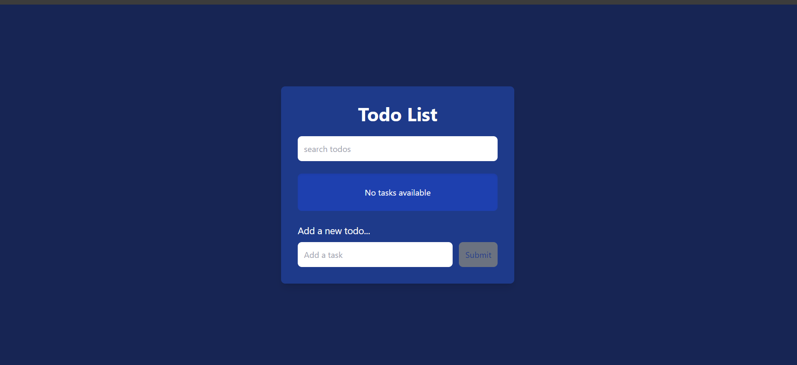
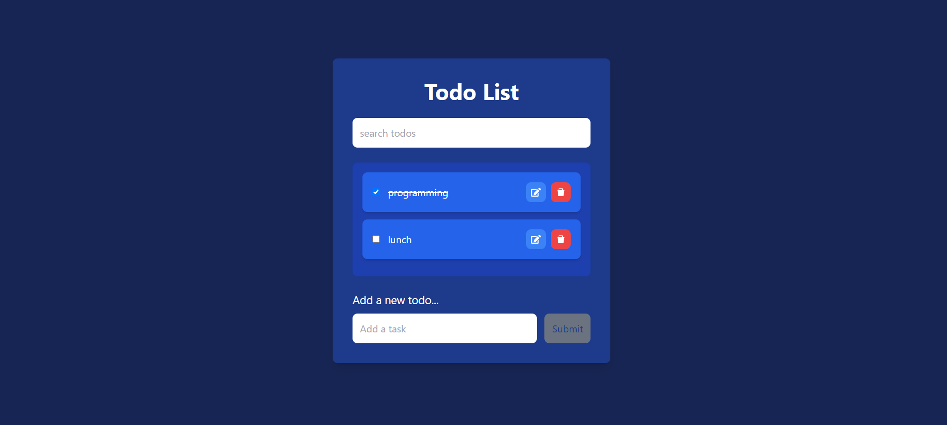

Slide 6
Conclusion
In conclusion, the Todo List application serves as a straightforward yet powerful tool for managing daily tasks. Built with React, it allows users to efficiently add, edit, and delete tasks while also marking them as completed. The integration of local storage ensures that your tasks persist even after closing the application, providing a seamless user experience.
This project not only demonstrates fundamental concepts in React, such as state management and component architecture, but also emphasizes the importance of user-friendly design and functionality.
I appreciate your attention throughout this presentation, and I’m now happy to answer any questions you may have!

